Slide 1
The Error Detecting and Correction Methods II.

Slide 2
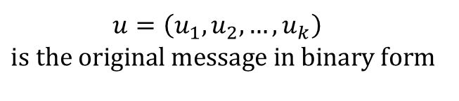
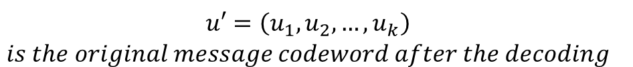
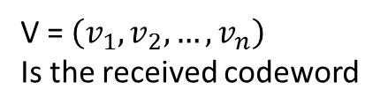
Wy we need it?
Channel
V
Decoding
u’
receiver
Encoding
C
source
U
Noisy-channel coding
$${\begin{aligned}u=\left(u_{1},u_{2},…,u_{k}\right) \\ \text{is} \text{the} \text{original} \text{m}\text{essage} \text{in} \text{binar}\text{y} \text{form} \\ \end{aligned}}^{}$$
$${c=\left(u_{1},u_{2},…,u_{k},c_{k+1},c_{k+2},…,c_{k+r}\right)=}^{}\left(c_{1},c_{2},…,c_{k},c_{k+1},c_{k+2},…,c_{k+r}\right)=\left(c_{1},c_{2}, …,c_{n}\right)$$
The original message extended by the redundant (r) bits to have possibility for error free decoding
V = $\left(v_{1},v_{2}, …,v_{n}\right)$
Is the received codeword
$${\begin{aligned}u′=\left(u_{1},u_{2},…,u_{k}\right) \\ is the original message codeword after the decoding\end{aligned}}^{}$$

Slide 3
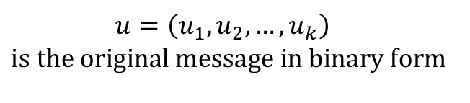
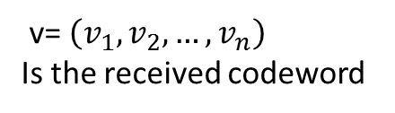
Wy we need it?
Channel
V
Decoding
u’
receiver
Encoding
C
source
U
Noisy-channel coding
$${\begin{aligned}u=\left(u_{1},u_{2},…,u_{k}\right) \\ \text{is} \text{the} \text{original} \text{m}\text{essage} \text{in} \text{binar}\text{y} \text{form} \\ \end{aligned}}^{}$$
$${c=\left(u_{1},u_{2},…,u_{k},c_{k+1},c_{k+2},…,c_{k+r}\right)=}^{}\left(c_{1},c_{2},…,c_{k},c_{k+1},c_{k+2},…,c_{k+r}\right)=\left(c_{1},c_{2}, …,c_{n}\right)$$
The original message extended by the redundant (r) bits to have possibility for error free decoding
If c=v, no error detected by the transfer, and removing the redundant bits we can conclude, that u=u’
v= $\left(v_{1},v_{2}, …,v_{n}\right)$
Is the received codeword
$${\begin{aligned}u′=\left(u_{1},u_{2},…,u_{k}\right) \\ is the original message codeword after the decoding\end{aligned}}^{}$$

Slide 4
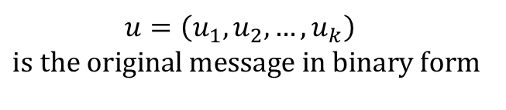
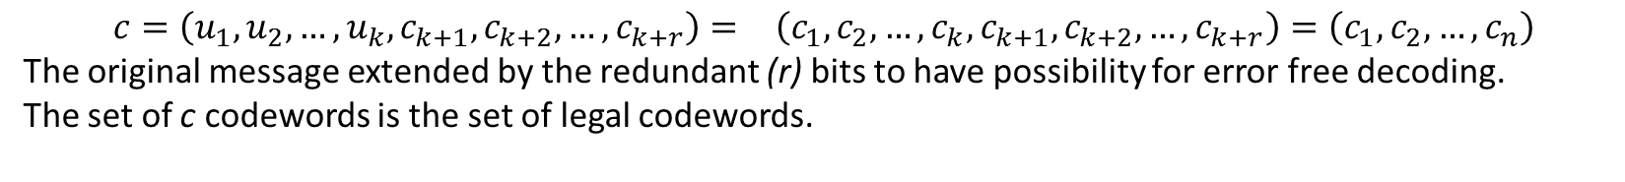
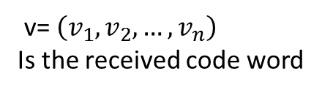
Wy we need it?
Channel
V
Decoding
u’
receiver
Encoding
C
source
U
Noisy-channel coding
$${\begin{aligned}u=\left(u_{1},u_{2},…,u_{k}\right) \\ \text{is} \text{the} \text{original} \text{m}\text{essage} \text{in} \text{binar}\text{y} \text{form} \\ \end{aligned}}^{}$$
$${c=\left(u_{1},u_{2},…,u_{k},c_{k+1},c_{k+2},…,c_{k+r}\right)=}^{}\left(c_{1},c_{2},…,c_{k},c_{k+1},c_{k+2},…,c_{k+r}\right)=\left(c_{1},c_{2}, …,c_{n}\right)$$
The original message extended by the redundant (r) bits to have possibility for error free decoding.
The set of c codewords is the set of legal codewords.
If c≠v, error is detected by the transfer (v is not element of the set of legal code words), and by the decoding we should find the neerest existing code word c from the set of legal codes c. It will be the extended code of the u’, the accepted code after the transfer of the original u.
Remember: it is possible only if we have acceptable Hamming distance in the legal code word set.
v= $\left(v_{1},v_{2}, …,v_{n}\right)$
Is the received code word
$${\begin{aligned}u′=\left(u_{1},u_{2},…,u_{k}\right) \\ is the original message codeword after the decoding\end{aligned}}^{}$$

Slide 5
The Hamming distance of a CODE (set of code words)
By specifying how the redundant bits are calculated, a complete list of legal code words can be created.
The two code words with the smallest Hamming distance can be searched from this list.
This distance is the Hamming distance of the entire code.

Slide 6
Error detection? Error correction?
When the receiver sees an invalid code word, it knows that a transmission error has occurred (the invalid code word is not in the legal code word dictionary).
Whether a false block code investigation has an error detection or error correction possibility depends on the Hamming distance of the code.
To be able to detect t error(s), a code with the t+1 Hamming distance must be used, because in such a code t bit error cannot pass the code word to another legal (valid) code word.
The lagal code word
Distance t between the codes
codewords on distance d

Slide 7
Error detection? Error correction?
Similarly, in order to correct t errors, we need 2t+1 Hamming-distance code, so that either two valid code words are so far apart that even, if the t bit changes, the error code word will be closer to original code than any other valid code word, thus, it can be clearly determined (assuming that a larger number of bit errors have a low probability). So there must be at least (ie min) 2t+1 distance between the two codes to be sure to "separate" them.

Slide 8
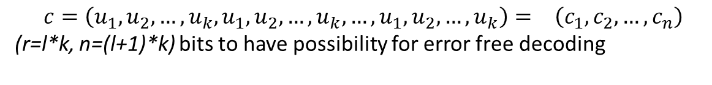


Elementary methods - the repetition code
Channel
V
Decoding
u’
receiver
Encoding
C
source
U
Too large? (channel capacity problem)
$${\begin{aligned}u=\left(u_{1},u_{2},…,u_{k}\right) \\ \text{i} \\ \end{aligned}}^{}$$
$${c=\left(u_{1},u_{2},…,u_{k},u_{1},u_{2},…,u_{k},…,u_{1},u_{2},…,u_{k}\right)=}^{}\left(c_{1},c_{2}, …,c_{n}\right)$$
(r=l*k, n=(l+1)*k) bits to have possibility for error free decoding
„The repetition code is one of the most basic error-correcting codes. In order to transmit a message over a noisy channel that may corrupt the transmission in a few places, the idea of the repetition code is to just repeat the message several (for example l times ) times. The hope is that the channel corrupts only a minority of these repetitions.”
„In the case of a binary repetition code, there exist two code words - all ones and all zeros - which have a length of n.
Therefore, the minimum Hamming distance of the code equals its length n.
This gives the repetition code an error correcting capacity of $\left\lfloor \frac{n−1}{2}\right\rfloor$ (i.e. it will correct up to $\left\lfloor \frac{n−1}{2}\right\rfloor$ errors in any code word).
If the length of a binary repetition code is odd, then it's a perfect code. The binary repetition code of length 3 is equivalent to the (3,1)-Hamming code (see the next slide example).

Slide 9
Example: The simplest binary repeat code is an n=3 code. The code repeats the signal three times: assigns 000 to 0 and 111 to 1. The distance between the two code words is d_{H} ((000); (111)) = 3. It is also true that d_{min}=3. The number of binary vectors of length 3 is 2³=8 and they can correspond to the vertices of the 3D unit cube.
d=3
111
000
100
Question: What is the distance from the 000 code? What codes are there for this distance?
011
Question: What is the distance from the 111 code? What codes are there for this distance?
Question: How do we decide which will be the correct code (000 or 111) by the decoding of incorrect codes 001, 010, 100, 110, 101, 011?
Where can we "push" the wrong "points"? How many "steps" do we put them into the right place?

Slide 10
Parity bits – to short for the correction?
„A parity bit is a bit that is added to a group of source bits to ensure that the number of set bits (i.e., bits with value 1) in the outcome is even or odd. It is a very simple scheme that can be used to detect single or any other odd number (i.e., three, five, etc.) of errors in the output. An even number of flipped bits will make the parity bit appear correct even though the data is erroneous. ”
See for examples: https://www.computerhope.com/jargon/p/paritybi.htm

Slide 11
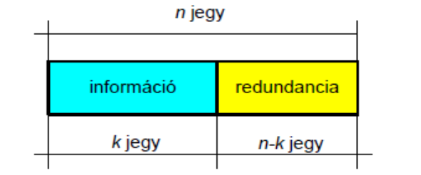
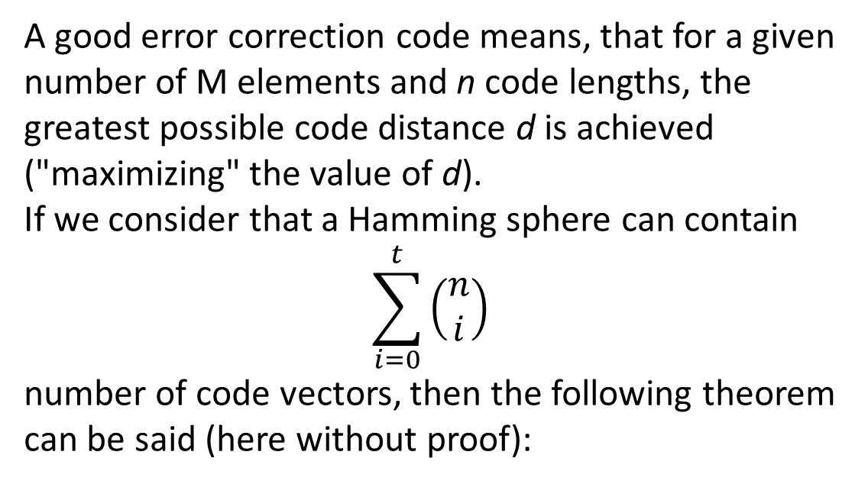
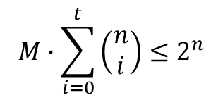
About the limits!
n bits of extended code
A good error correction code means, that for a given number of M elements and n code lengths, the greatest possible code distance d is achieved ("maximizing" the value of d).
If we consider that a Hamming sphere can contain
$$\sum_{i=0}^{t}{\left(\begin{matrix}n \\ i\end{matrix}\right)}$$
number of code vectors, then the following theorem can be said (here without proof):
k bits of source message code
r=n-k redundant control bits of the extended code
There is a Hamming boundary for any block code that corrects up to t errors as follows:
$$M∙\sum_{i=0}^{t}{\left(\begin{matrix}n \\ i\end{matrix}\right)}≤2^{n}$$
Block codes that satisfy equality are called perfect codes.

Slide 12
Further possibilities: Linear codes
„In coding theory, a linear code is an error-correcting code for which any linear combination of codewords is also a codeword. Linear codes are traditionally partitioned into:
block codes and convolutional codes,
although turbo codes can be seen as a hybrid of these two types. ”
https://video.search.yahoo.com/yhs/search?fr=yhs-blp-default&hsimp=yhs-default&hspart=blp&p=linear+codes#id=38&vid=470cbbee9af1456c5c02986a5ac9f62c&action=view

Slide 13
Math background
Operators on {0,1} set, XOR
Vector space
„basic” of the vektor space, linear combination of vectors
Generator Matrix (rows are the basis of the code vectors constraction)

Slide 14
To learn about, with examples:
https://www.ee.iitb.ac.in/~sarva/courses/EE605/2014/slides/LinearBlockCodes.pdf
https://video.search.yahoo.com/yhs/search?fr=yhs-blp-default&hsimp=yhs-default&hspart=blp&p=linear+codes#id=38&vid=470cbbee9af1456c5c02986a5ac9f62c&action=view

Slide 15
Is the Linear code able to correct errors?
https://www.youtube.com/watch?v=DfSvzkgUNNs

Slide 16
Hamming codes
http://math.mit.edu/~goemans/18310S15/Hamming-code-notes.pdf
web2.aabu.edu.jo/tool/course_file/lec_notes/901321_chapter 10

Slide 17
Home work
Find an example for the linear code set (it can be from the net), but write on the main elements (type, generator matrix, H parity matrix, …)
Write on the analized example in handwritten form, and upload the pictures of your solution to the Moodle! (deadline April, 18th.)

